Slide 1
Healthcare Data Dashboard

Slide 2
Overview
This project provides an interactive dashboard built with Streamlit, Plotly, and MySQL, aimed at analyzing healthcare data and offering insights on patient admissions, diagnosis trends, bed occupancy, doctor performance, and billing information.

Slide 3
Features
Visualize trends in patient admissions over time.
Analyze the most common diagnoses in the healthcare system.
View detailed bed occupancy rates and breakdowns.
Track doctor performance and their average billing.
Understand the relationship between diagnoses, length of stay, and hospital bed usage.
Insights into health insurance billing by diagnosis and bed occupancy.

Slide 4
Solution Architecture
Data Source:
A MySQL database (Healthcare) contains healthcare-related data, such as patient admissions, diagnosis, billing, bed occupancy, etc.
Backend:
MySQL Connector: Used to connect the dashboard to the MySQL database and execute SQL queries.
Pandas: Data analysis and transformation library used to process the SQL query results into data frames.
SQLAlchemy: Utilized for data insertion and interaction with MySQL through the to_sql() function.
Frontend:
Streamlit: Provides an interactive frontend to display visualizations and reports.
Plotly: Used for creating visually engaging plots (bar charts, pie charts, line charts).

Slide 5
Use Cases
Capacity Planning:
By analyzing bed occupancy patterns, hospitals can predict future needs and prepare for peak times, thus preventing resource shortages.
Operational Efficiency:
The dashboard's ability to monitor doctor performance, length of stay, and diagnosis trends can help hospital management optimize staffing, medical equipment, and beds.

Slide 6
Use Cases
Financial Management:
Total billing and health insurance analytics help with budgeting, identifying trends in revenue generation, and managing healthcare costs.
Trend Forecasting:
By analyzing seasonal admissions and diagnosis data, hospitals can forecast demand for specific services or specialties and prepare in advance.

Slide 7
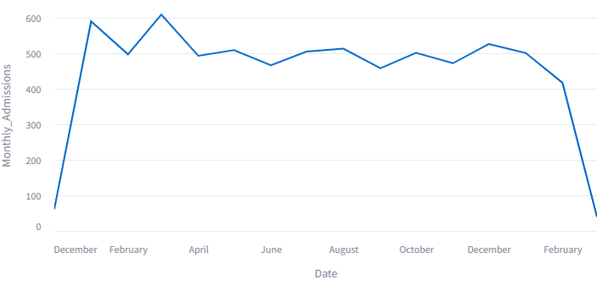
Visualizations Overview
Trends in Admission Over Time analysis

Slide 8
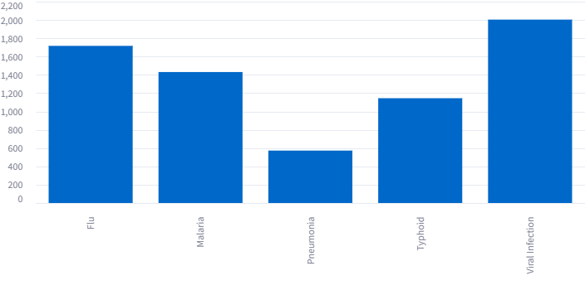
Diaganosis analysis

Slide 9
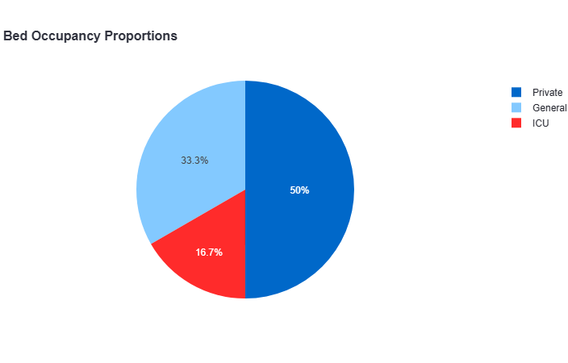
Bed_Occupancy analysis

Slide 10
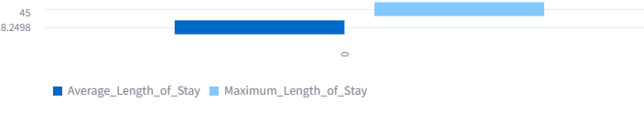
Length of Stay Distribution

Slide 11
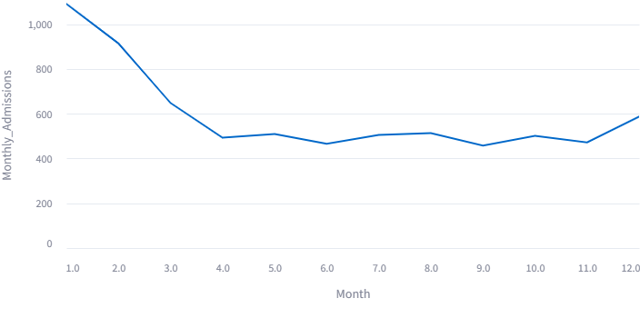
Seasonal Admission Patterns

Slide 12
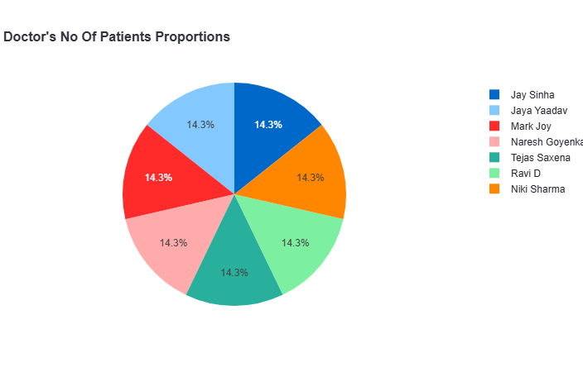
Doctor Analysis

Slide 13
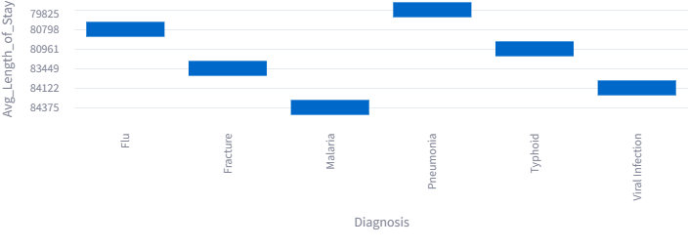
Average Length of Stay by Diagnosis

Slide 14
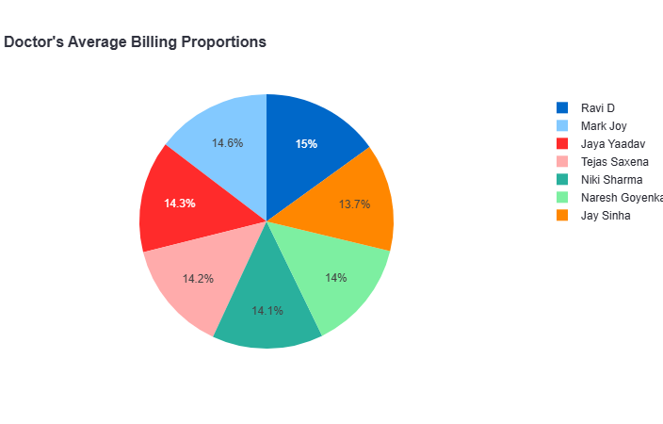
Doctor Average Billing

Slide 15
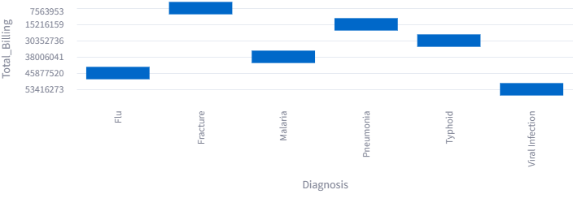
Total Billing by Diagnosis

Slide 16
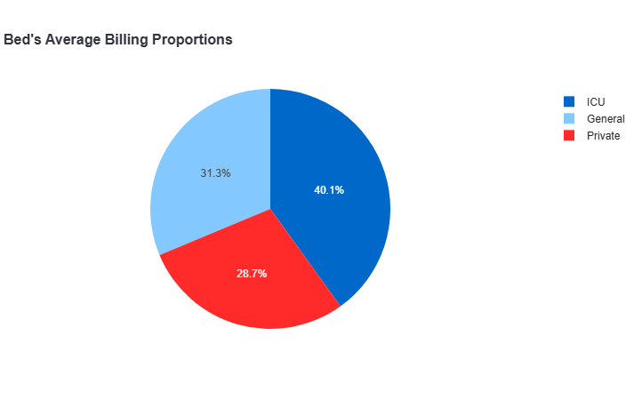
Average Billing by Bed Occupancy

Slide 17
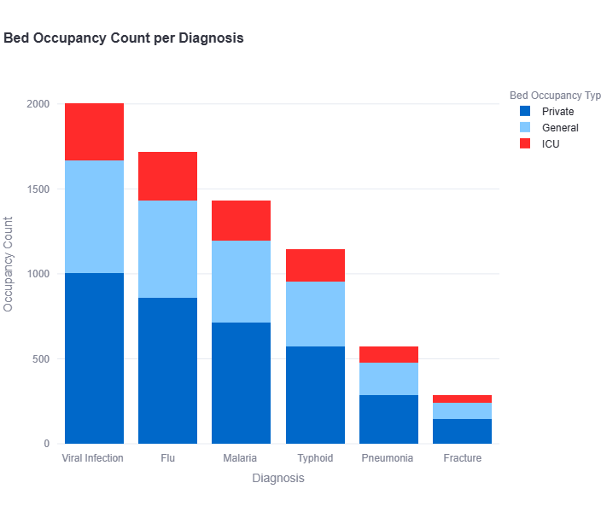
Bed Occupancy Count per Diagnosis

Slide 18
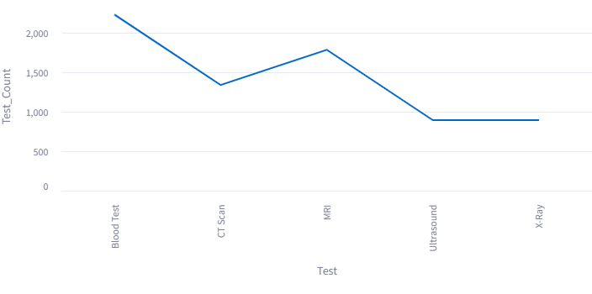
Test Count per Diagnosis

Slide 19
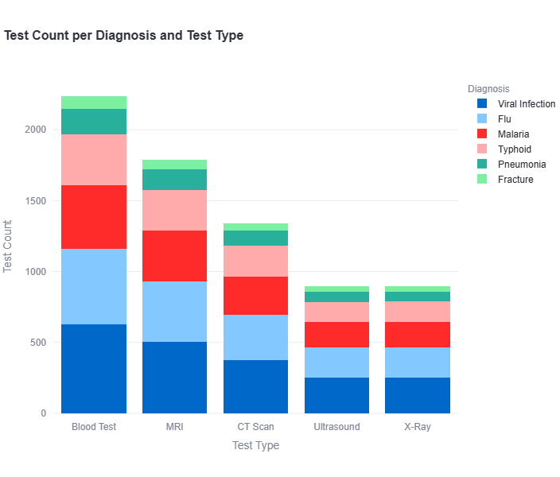
Test Count per Diagnosis and Test Type

Slide 20
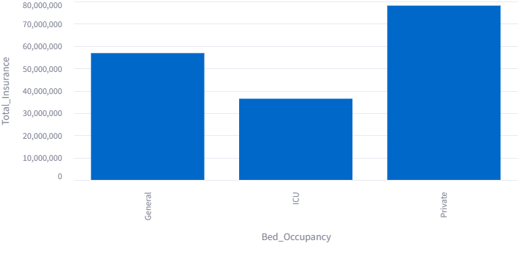
Total Health Insurance by Bed Occupancy

Slide 21
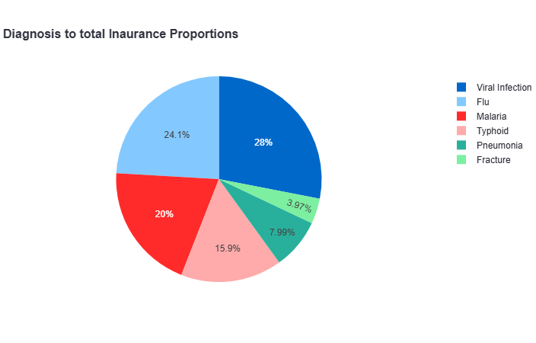
Total Health Insurance by Bed Occupancy

Slide 22
Conclusion
In conclusion, these dataset offer valuable insights into patient trends, diagnoses, doctor performance, and hospital resource usage, helping healthcare providers optimize operations and improve patient care.

